Slide 1
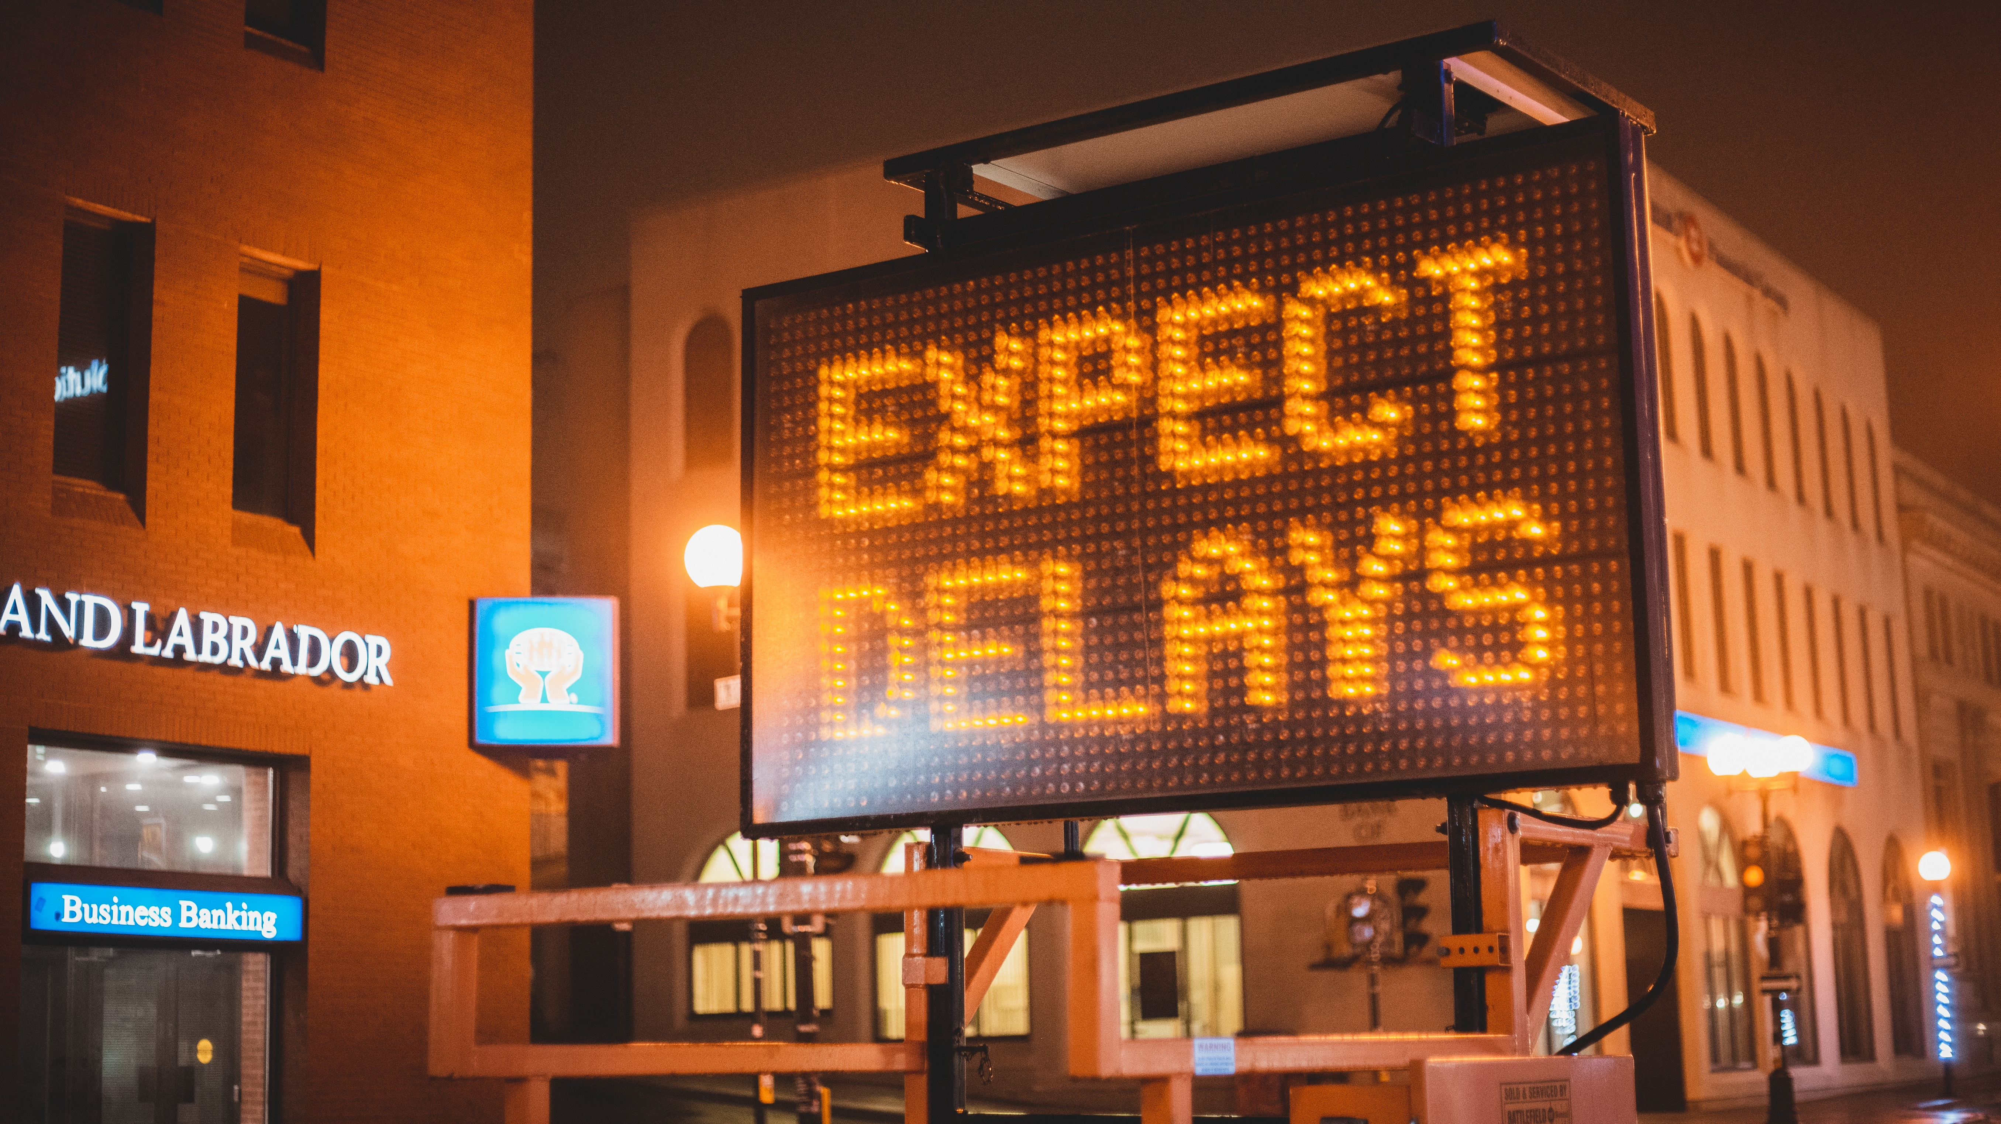

Ttc delays
Presented by: Tejshwi Nakarmi, Jason Feng, Khandker (Faim) Husssain
Brainstation Team
Toronto Campus
Final Project

Slide 2
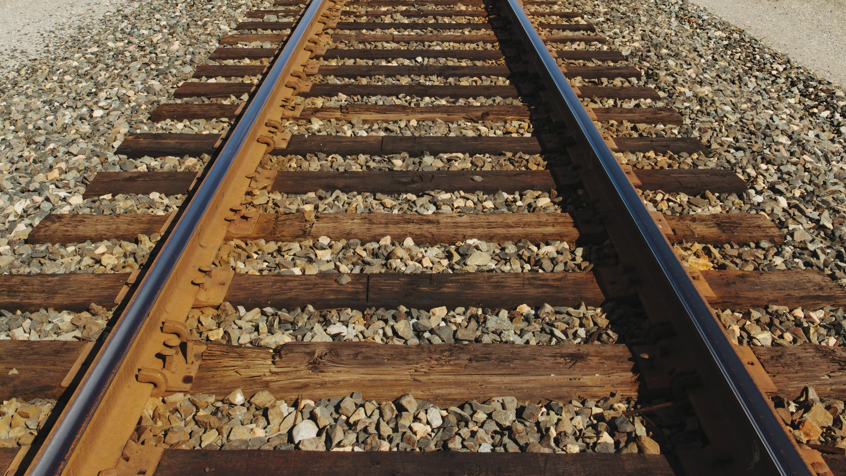
Introduction
Has anyone faced TTC Delay?
How does it feel to get stuck in the tunnel for 30 minutes or even an hour inside the subway?
Taking the bus or the streetcar, what if the bus breaks down and you are out stranded waiting for the bus to arrive?

Slide 3
Table of contents
1. Thesis
2. Process
3. Questions regarding data
4. Present Data
5. Findings
6. Suggestions

Slide 4

hypothesis
Main hypothesis:
1. TTC transportation service (subway, streetcars and bus) does not have any significant time delay differences.
2. The time of the day or week also does not have any significant time delay differences.
Alternative hypothesis: The TTC services and time of day/week do have significant delay differences.
Analysis: The data is not properly distributed, inaccurate entry, and subway names/routes entered are duplicated thus, the main hypothesis is rejected.
Suggestion for Improvement: Using TTC public data, the purpose was to see what TTC could do analytically to better the system within a reasonable budget.
* All data are retrieved from the City of Toronto Open data

Slide 5

process
Cleaning the data provided from the TTC was a roller coaster. Several columns in the subway, bus and streetcar data, such as route, station name and direction, were filled with numerous misspellings, short forms, double entry and unknown values which we were not able to understand. Thus, intense cleaning of the data was attempted and were cleaned up sufficient enough to present a heatmap of delay reports as well the graphs for each TTC transportation services.

Slide 6

KeyWORDS
SUDP: Disorderly patron
MUIS: Injured or ill customer- accepted medical help
SUO: Passenger, other
MUPAA: Passenger alarm activated- no trouble found
MUIRS: Injured or ill customer- refused medical help
SUUT: Unauthorized at track level

Slide 7
Main question regarding data
What is the main reason for the TTC delay?
What times of the days are most impacted by the delay?
Is there any relationship between the time and the date for the delay?
Which lines, routes and stations were impacted the most because of the delay?

Slide 8
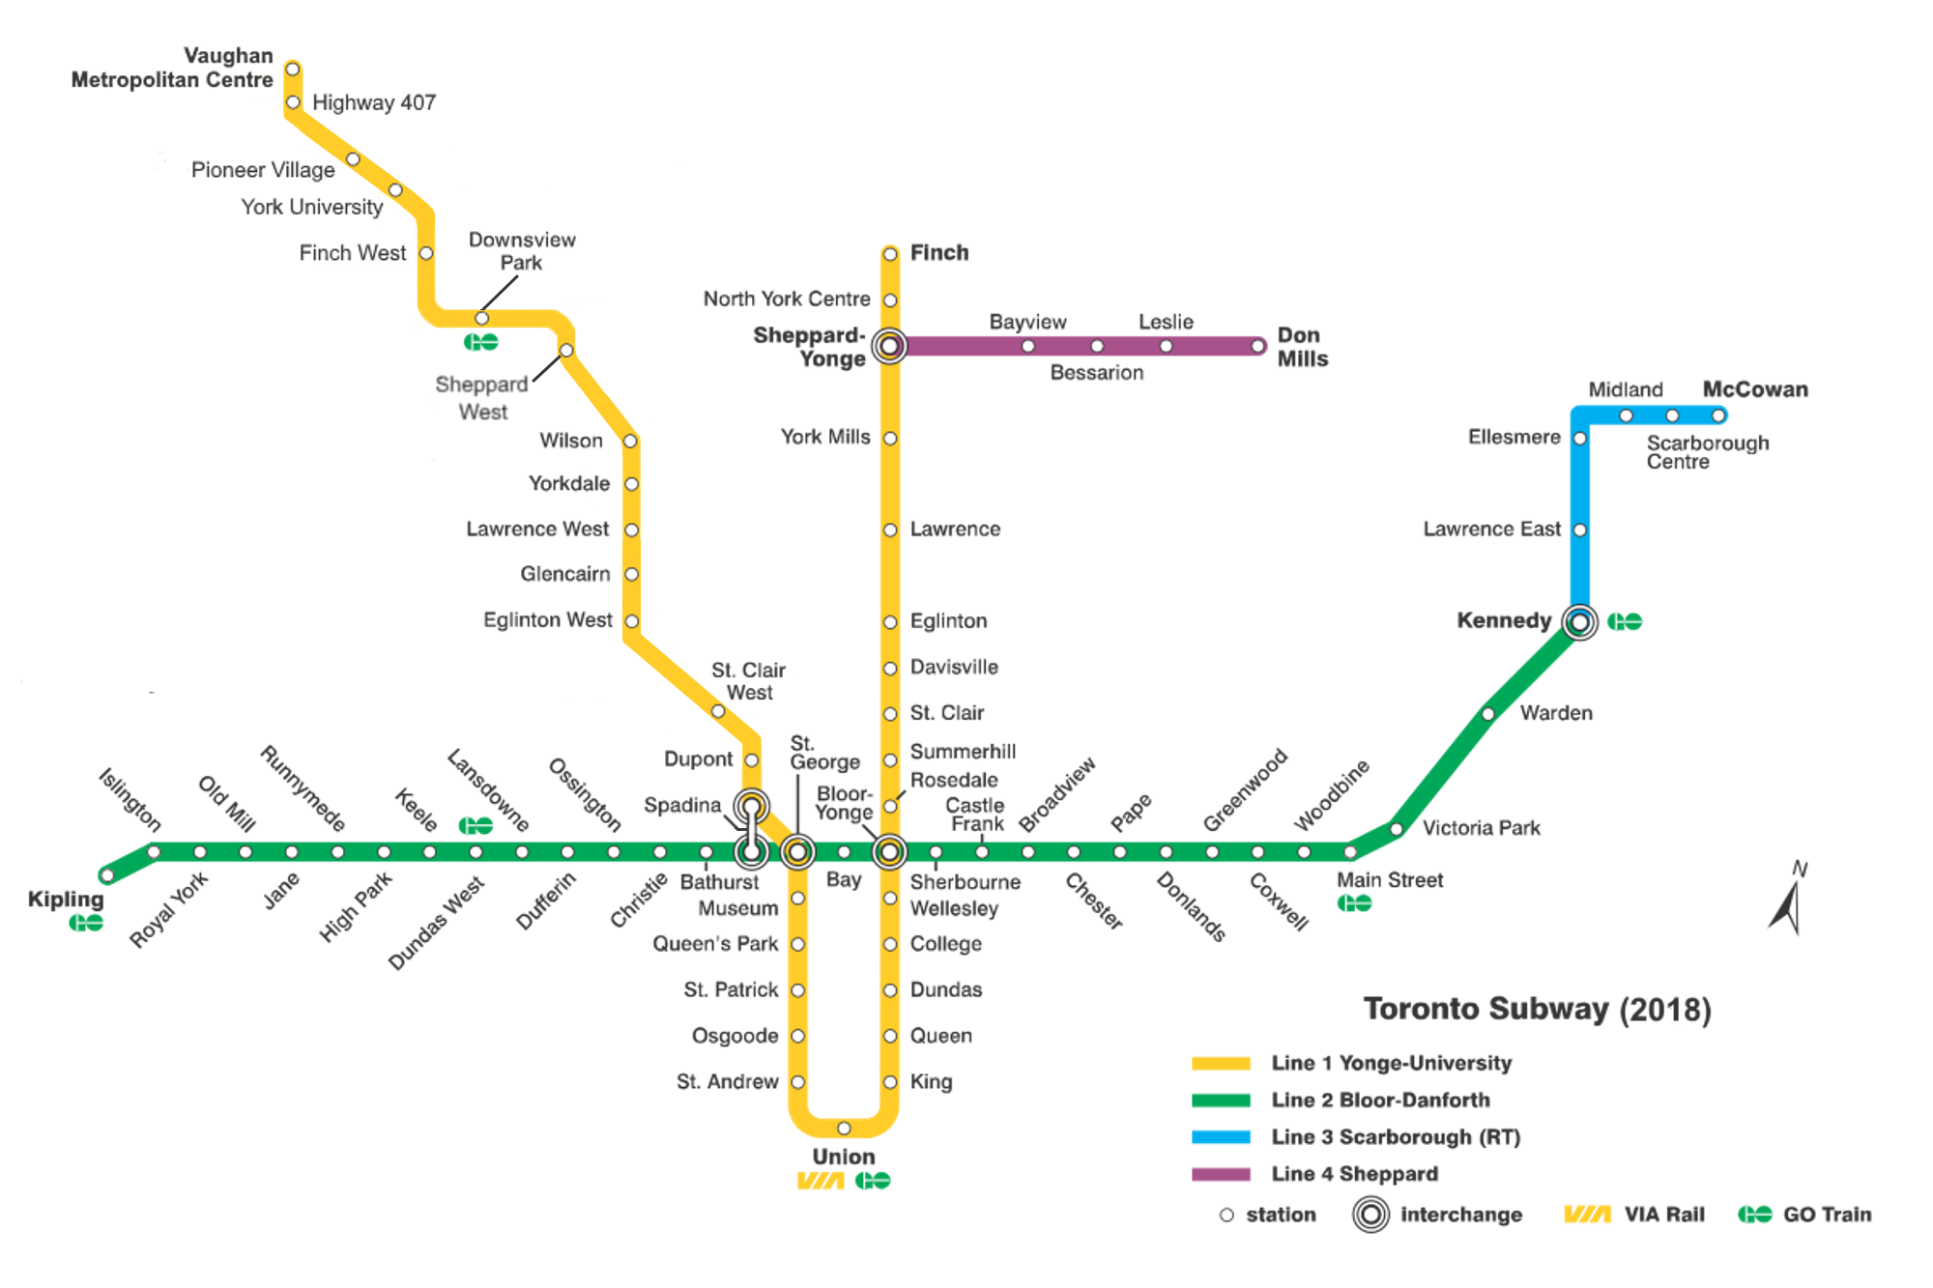
TTC SUBWAY DATA

Slide 9
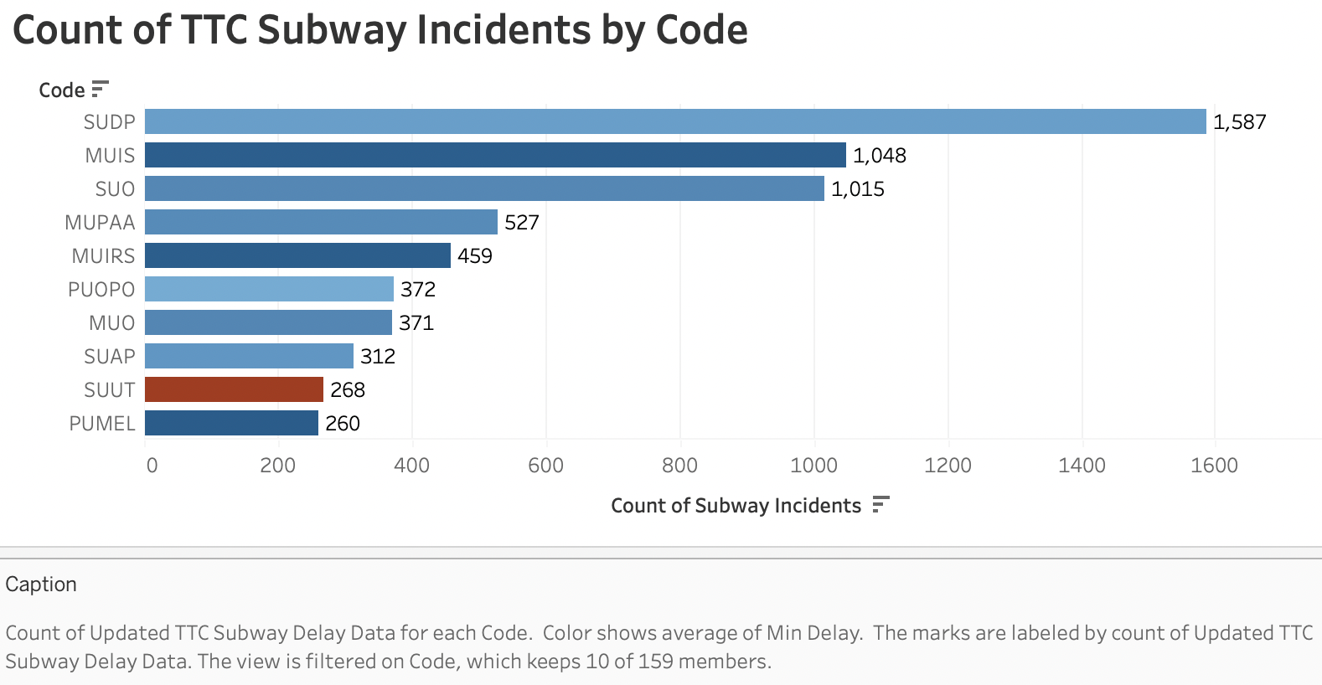
2 findings:
SUUT (if unauthorized personnel are in the track, severe delay)
MUIS/MUIRS (when combined rivals SUDP; 1,507 vs 1,587)

Slide 10
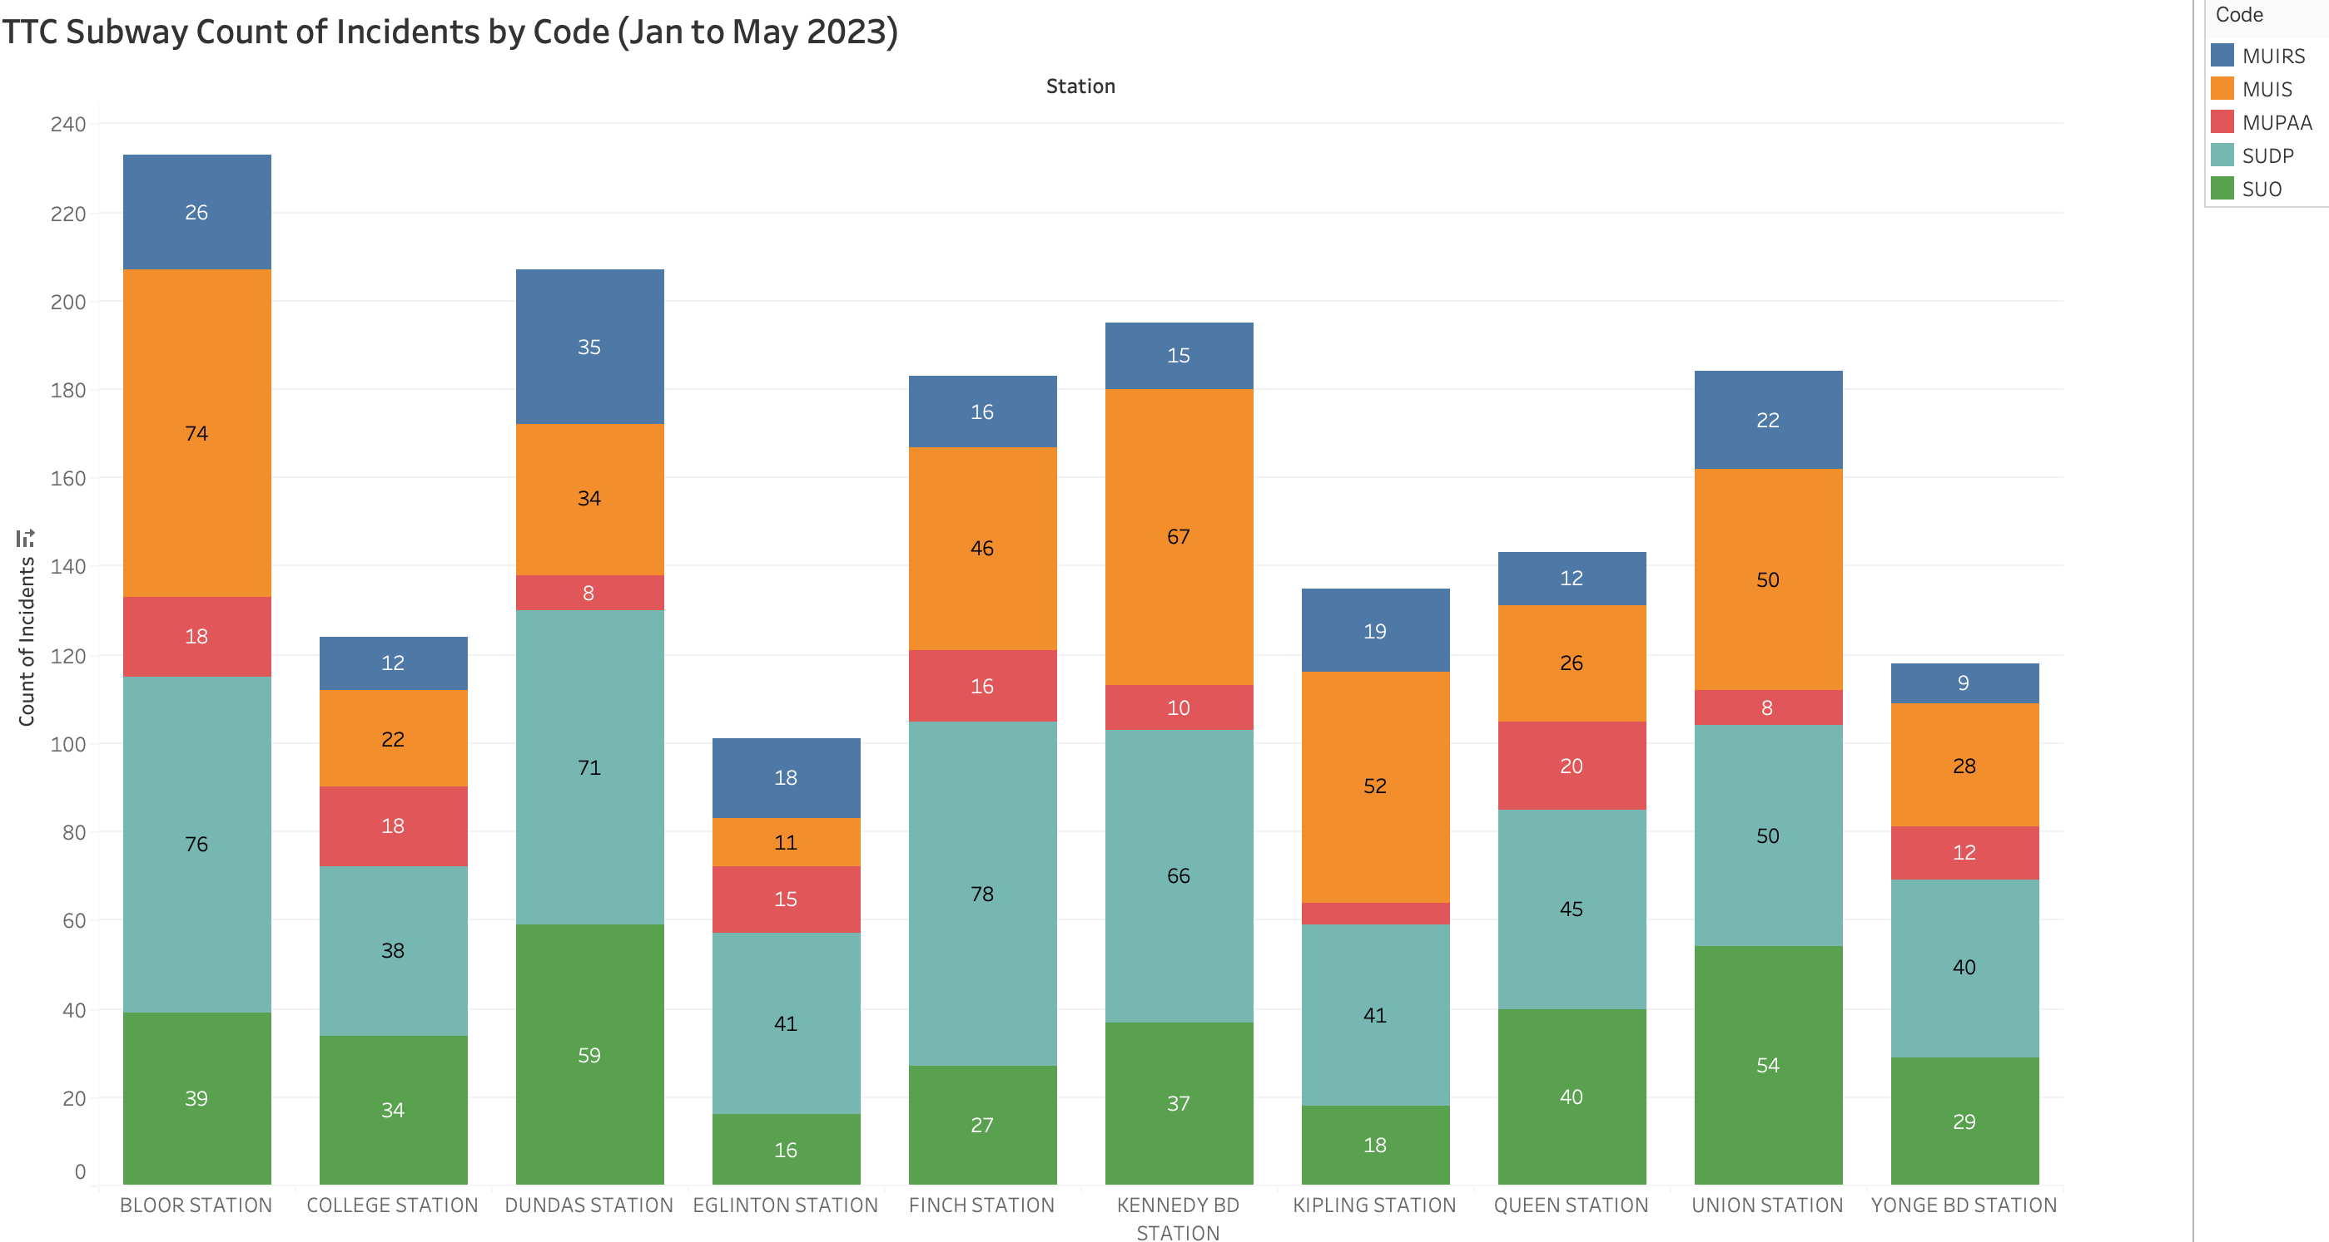
Top 10 stations incidents by code
Bloor Station, Finch Station and Kipling Station face delays due to medical emergency help being requested and accepted (MUIS)

Slide 11
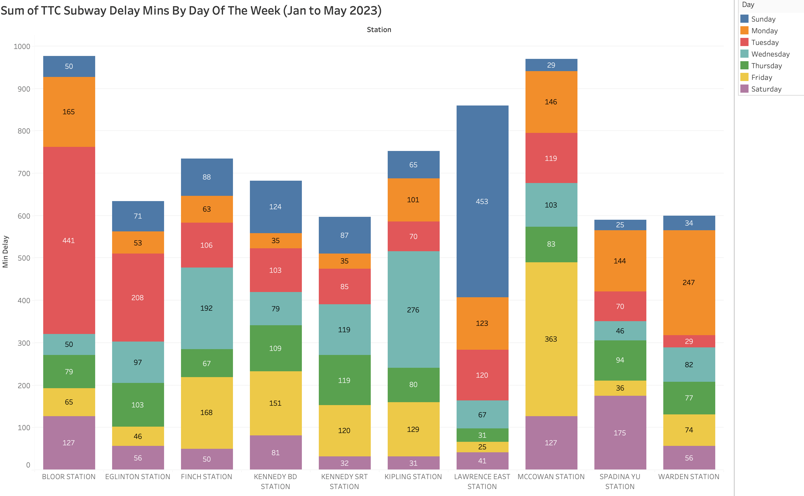
Tuesdays seem to be the most delayed days besides Monday and Wednesday

Slide 12
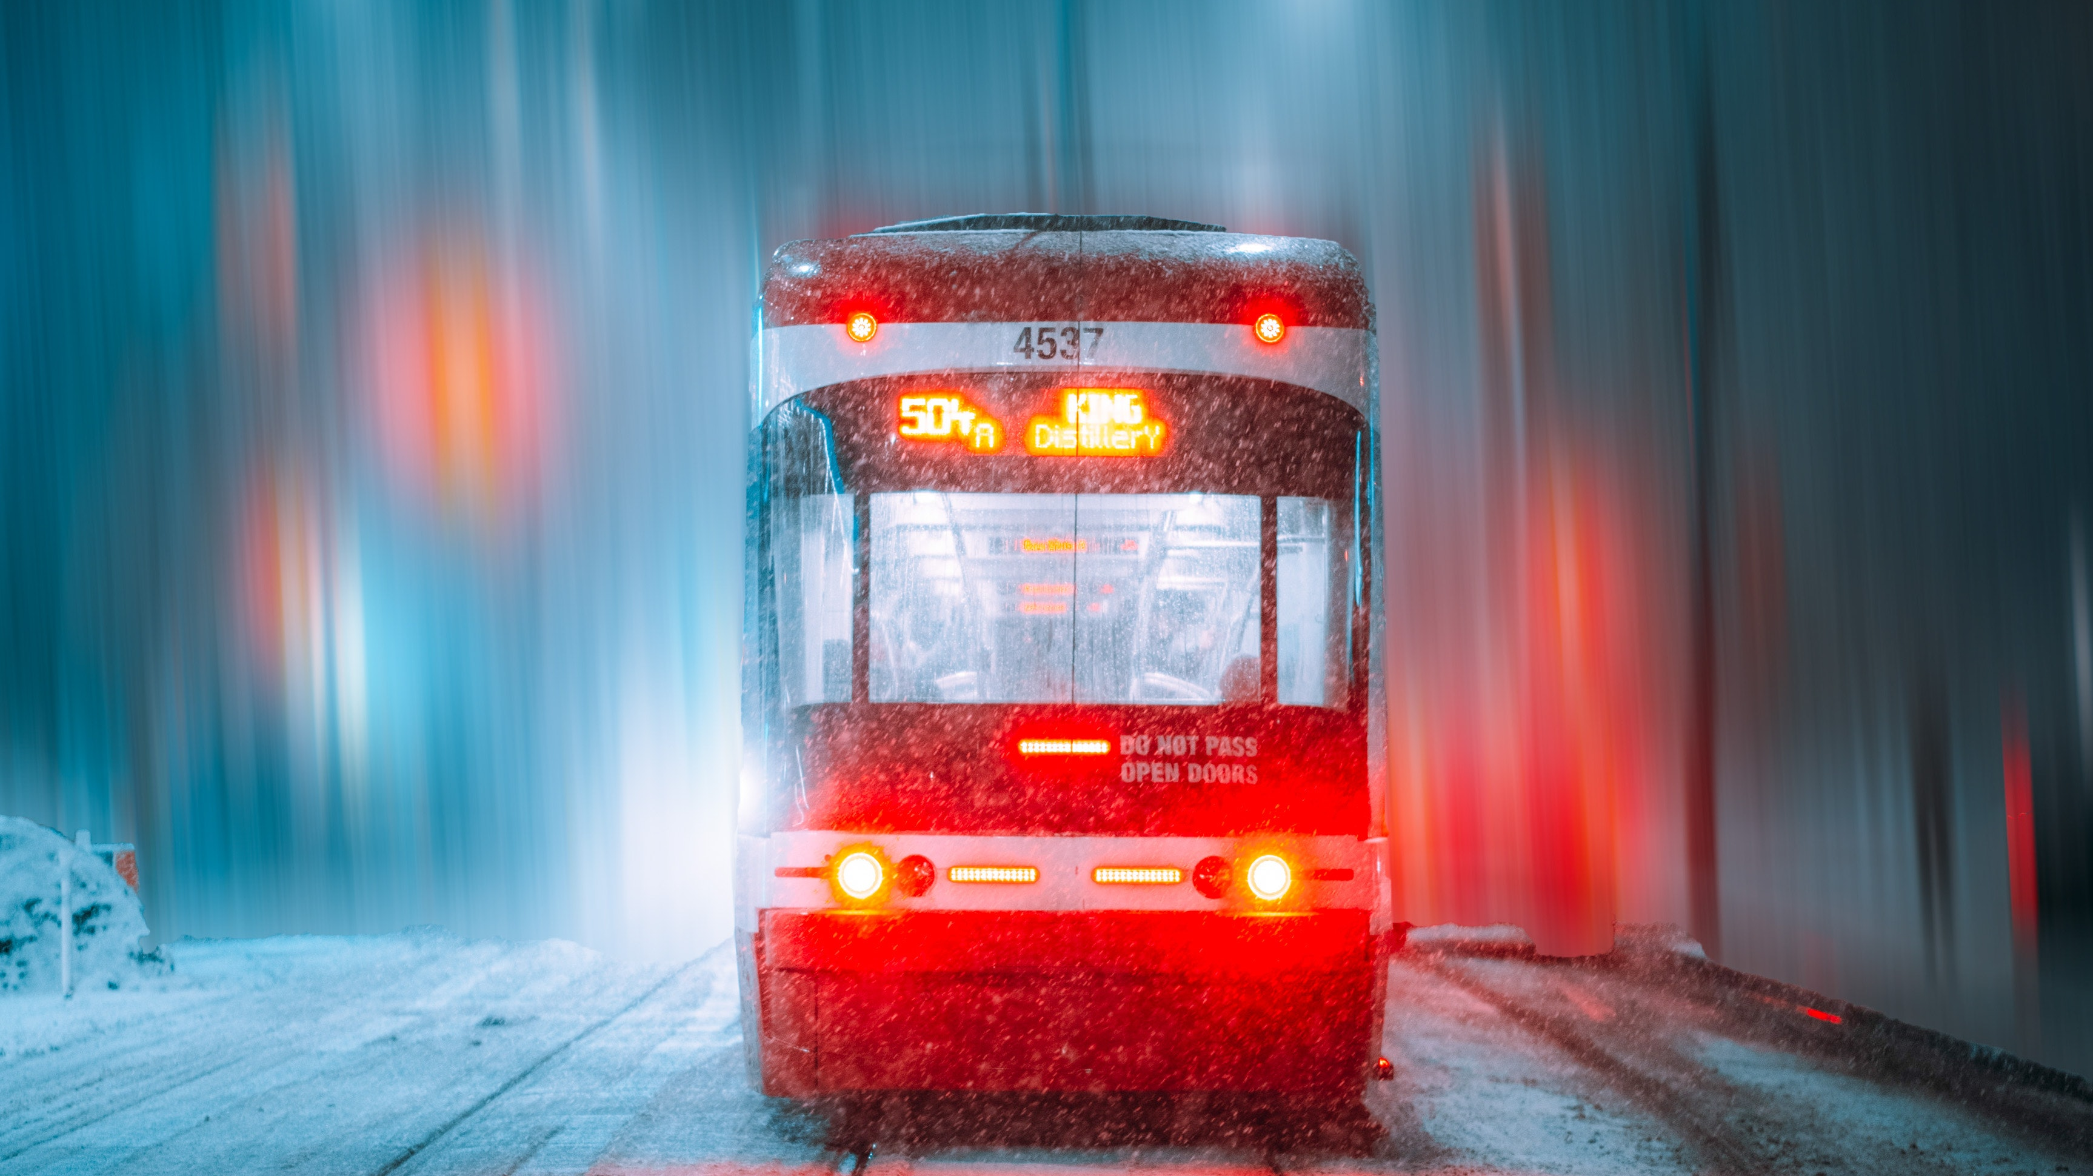
TTC STREETCAR DATA

Slide 13
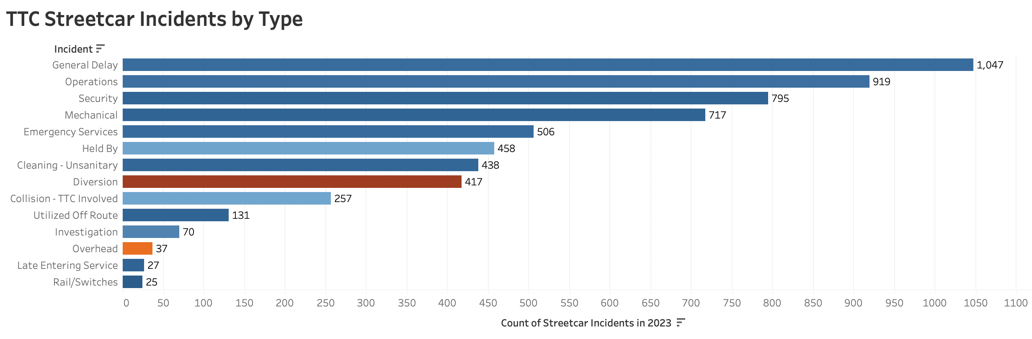
Diversion is the severe cause for delays rather than general delay

Slide 14
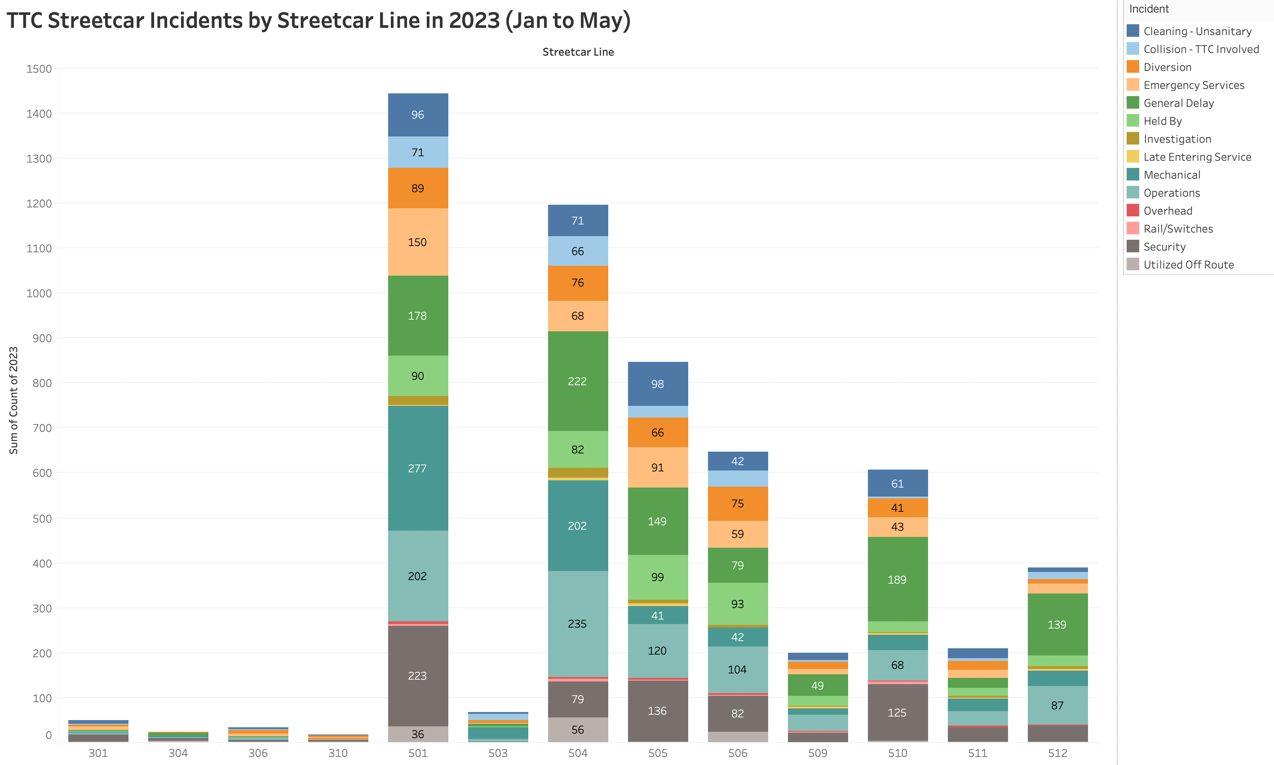
King streetcar line (504) is the most travelled streetcar line however, due to construction on Queen streetcar line (501) delays are affected the most as of Jan to May 2023

Slide 15
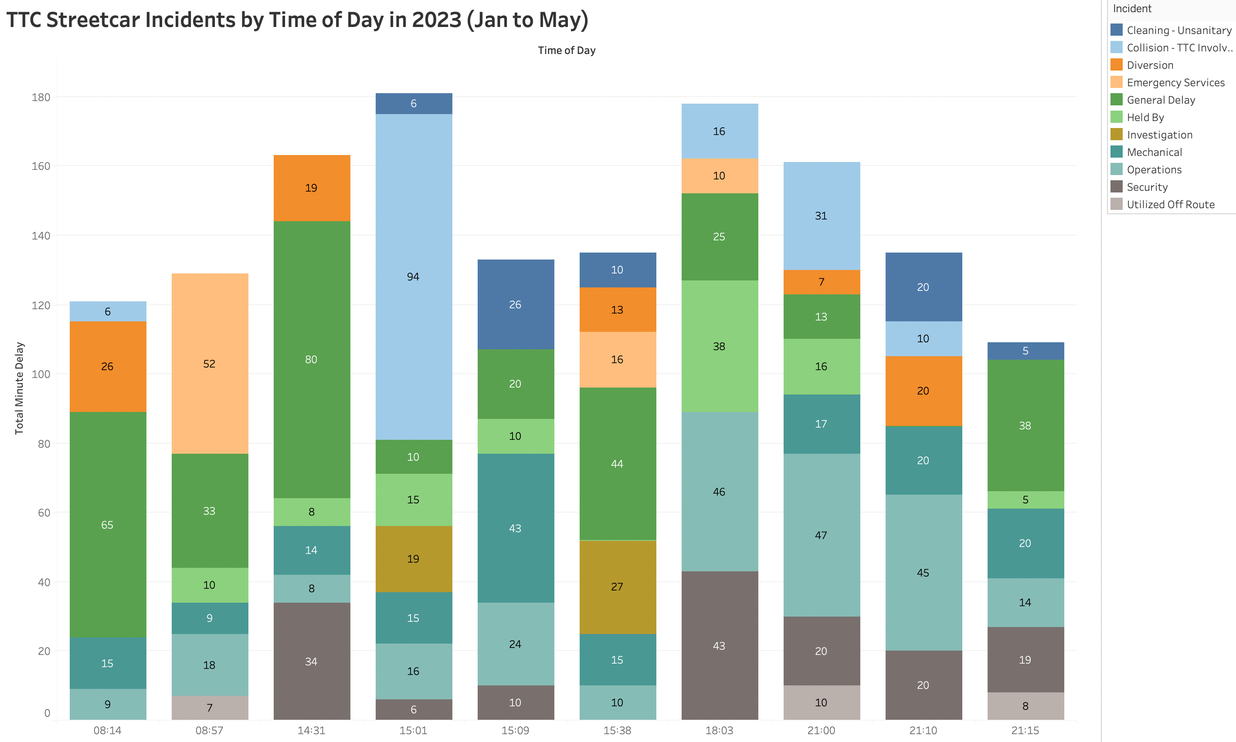
The assumption is that rush hours are most likely to be delayed but the findings show that during after-hours (night) downtown streetcars are mostly affected.

Slide 16
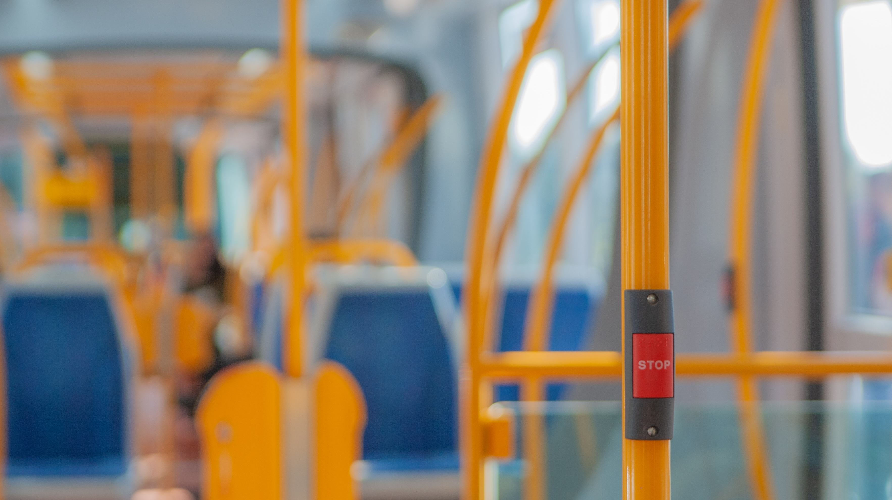
TTC BUS DATA

Slide 17
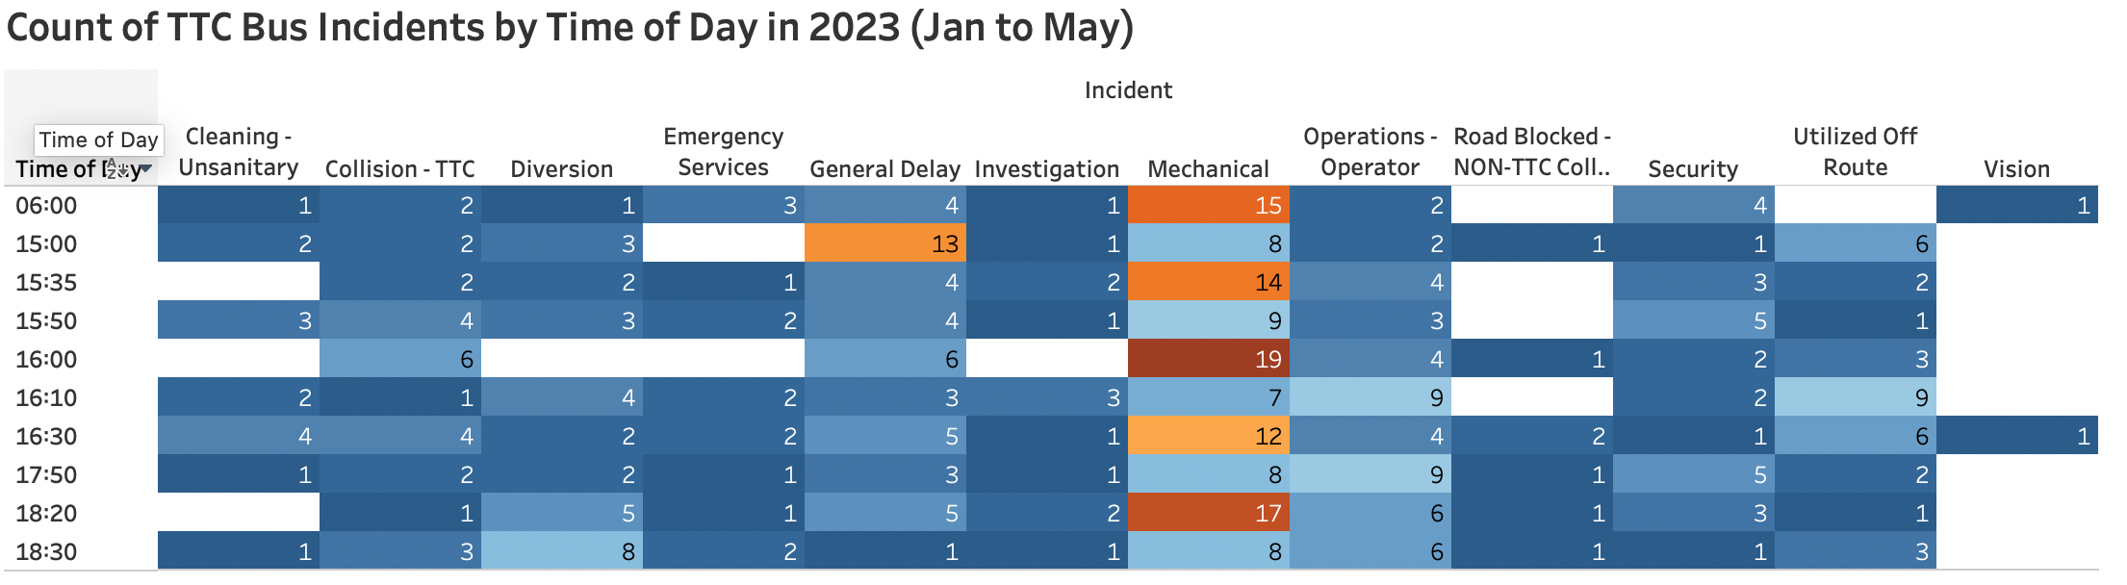
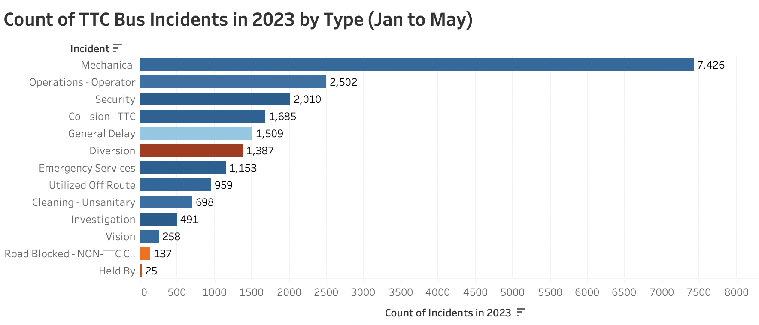
Rush hour time delay by bus only; 4pm and 6pm
Morning Rush Hour:
6:30 AM – 10:00 AM
During the Day:
10:00 AM – 3:30 PM
Afternoon Rush Hour:
3:30 PM – 7:00 PM
Off Hours:
7:00 PM – 6:30 AM
Diversion is the main reason for bus delays besides mechanical

Slide 18
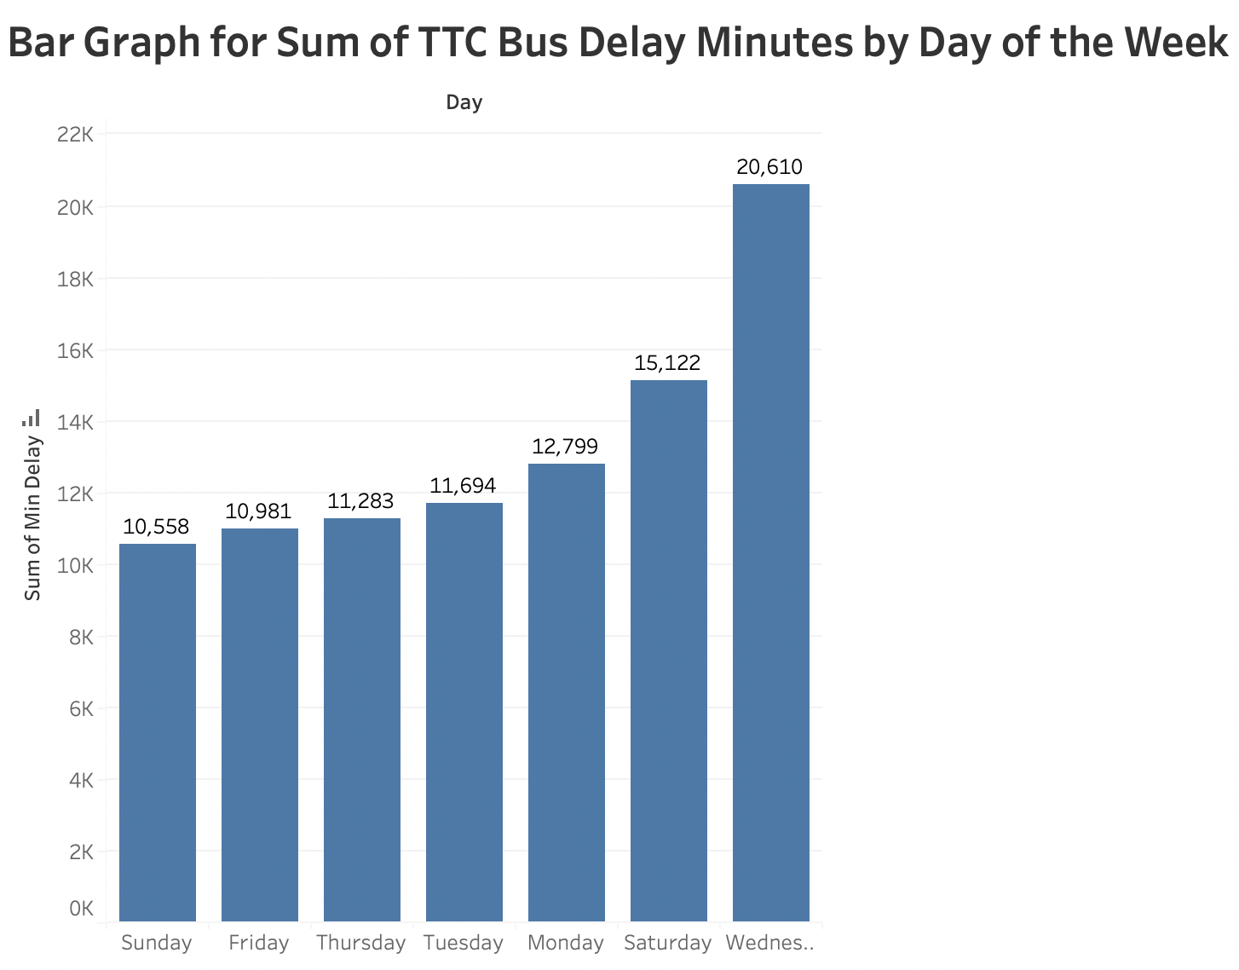
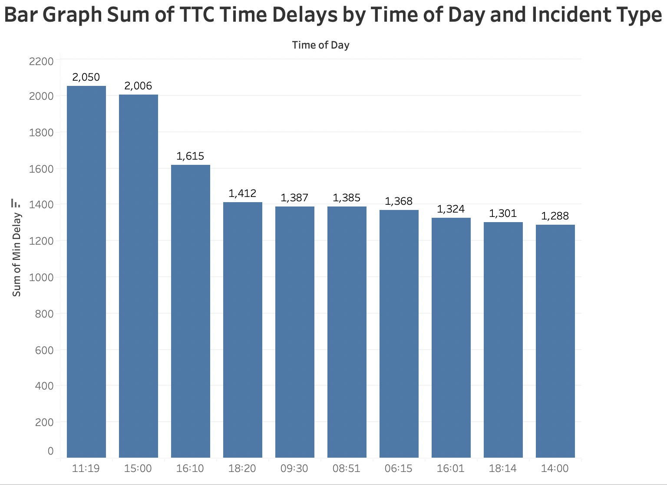
Rush hour timings: 11am in the morning seems to have the most delays followed by 3 pm in the afternoon
In a week; Wednesday out of all the days seems to be the day the delays occurred the most

Slide 19
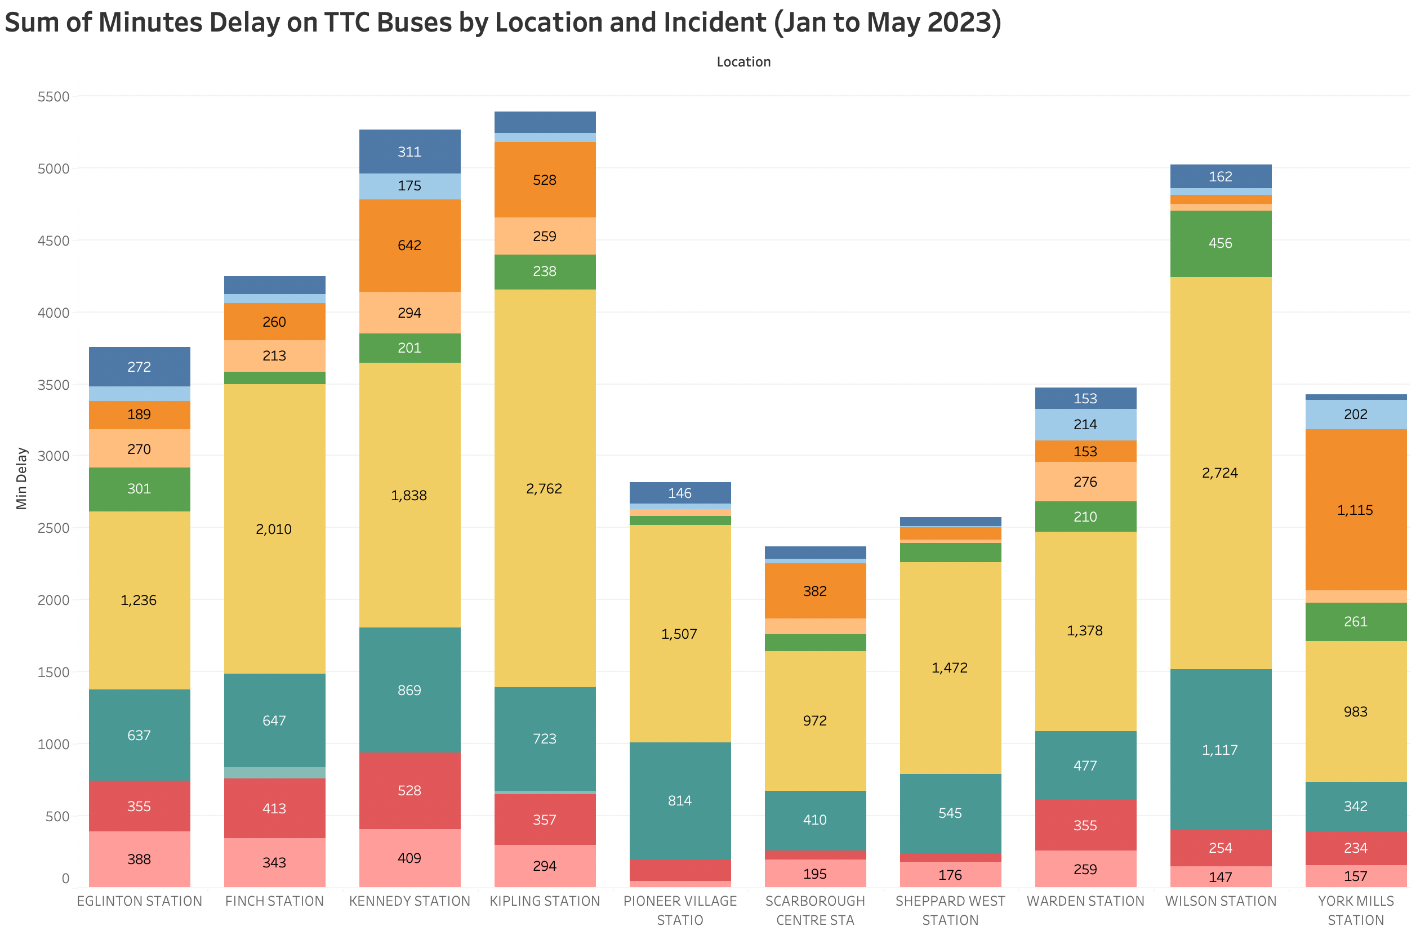
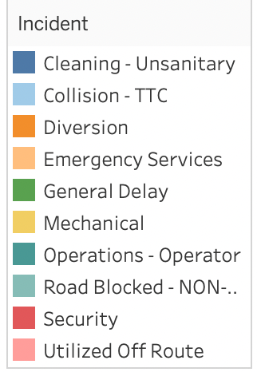
The location with the most bus delays by the time seems to mostly occur:
1. Kennedy, Kipling and Wilson stations for mechanical.
2. YorkMills, Kennedy and Kipling stations due to diversions.

Slide 20
Main question regarding data
What is the main reason for the TTC delay?: besides mechanical, the diversion was one of the main reason for TTC delay
What times of the day are most impacted by the delay?: 11am followed by 3 pm
Is there any relationship between the time and the date for the delay?: no correlation
Which lines, routes and stations were impacted the most because of the delay?: Bloor, Dundas, Finch, Kennedy and Union.

Slide 21
Findings
The top 5 stations for reporting delay incidents are Bloor, Dundas, Finch, Kennedy and Union.
The day of the time/ week does have significance in delays
Tuesday faces more delays than any other day for Subways
Besides diversion, MUIS (ill or injured- medical help accepted incidents) plays another factor in TTC subway delays.
Rush hour is not the only hour that faces delays but after hours (night) also faces delays
When all the data are compared across the 3 TTC services (subway, bus and streetcar) for the delay; it’s clear that the populations are significantly different. However, they do not differ in terms of the day of the week or time of day.

Slide 22

suggestions
The most notable delays are out of TTC controls but the analytical finding such as mechanical and or diversion are the most contributing factor for delays.
Incidents such as unauthorized personnel on the tracks could be something TTC can consider taking control of by installing platform screen doors ‘
Incidents like medical emergency and or emergency buttons can be followed with proper precautions and guidelines.
Notes:
incidents per riders
incidents per routes
charts: delays and station? Name of station sort the top 10
traffic data
visual analysis- cluster of roads and neighbourhood

